Slide 1
Module 7
Comparing Database Options in Azure
Notes:
Presentation: 90 minutes
Case Study: 60 minutes
Lab: 90 minutes
After completing this module, students will be able to:
Compare and contrast various database options on Azure.
Identify data streaming options for large-scale data ingest.
Identify longer-term data storage options.
Required materials
To teach this module, you need the Microsoft PowerPoint file: 20535A_12.pptx.
Preparation tasks
To prepare for this module, you should:
Read all of this module’s materials.
Practice performing the demonstrations and labs.
Work through the Module Review and Takeaways section to determine how you will use the information to reinforce student learning and promote knowledge transfer to on-the-job performance.
As you prepare for this class, it is imperative that you complete the labs yourself. This gives you an understanding of how the labs work and the concepts that each covers, so that you can provide meaningful hints to students who might have issues. Furthermore, it will help guide your lecture to ensure that you discuss the concepts that the lab covers.
The Azure portal is continually being improved, and the user interface might have updated since this module was written. Therefore, before teaching this module, familiarize yourself with the latest version of the Azure portal.
20535A
7: Comparing Database Options in Azure

Slide 2
Module Overview
Relational Databases NoSQL Services Azure Cosmos DB Data Storage & Integration Data Analysis Web Apps & SQL Case Study
Notes:
20535A
7: Comparing Database Options in Azure

Slide 3
Lesson 1: Relational Databases
Azure SQL Database Third-Party Databases in Azure
Notes:
20535A
7: Comparing Database Options in Azure

Slide 4
Azure SQL Database
SQL-as-a-Service Offering:
Fully managed
Automatically replicated
Compatible with existing TDS-capable software:
Visual Studio
SQL Server Management Studio
Entity Framework
Managed using existing tools, the CLI, PowerShell or the Portal
Performance measured in a predictable manner:
Database Throughput Units (DTUs)
Notes:
DTUs are used to describe the capacity for a specific tier and performance level. DTUs are designed to be relative so that you can directly compare the tiers and performance levels. For example, the Basic tier has a single performance level (B) that is rated at 5 DTU. The S2 performance level in the Standard tier is rated at 50 DTU. This means that you can expect ten times the power for a database at the S2 performance level than a database at the B performance level in the Basic tier.
20535A
7: Comparing Database Options in Azure

Slide 5
Tiers
Tiers
Small dbs
Single active operation
Dev/Test
Small scale apps
5 DTU
Great option for cloud apps
Multiple operations
Workgroup or web apps
10 – 100 DTU
High transaction volumes
Large number of users
Multiple operations
Mission critical apps
100 – 800 DTU
BASIC
STANDARD
PREMIUM
Notes:
Migration between tiers is possible (portal, PowerShell or REST API).
20535A
7: Comparing Database Options in Azure

Slide 6
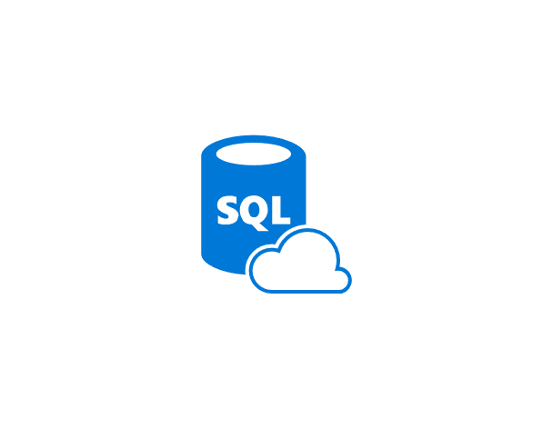
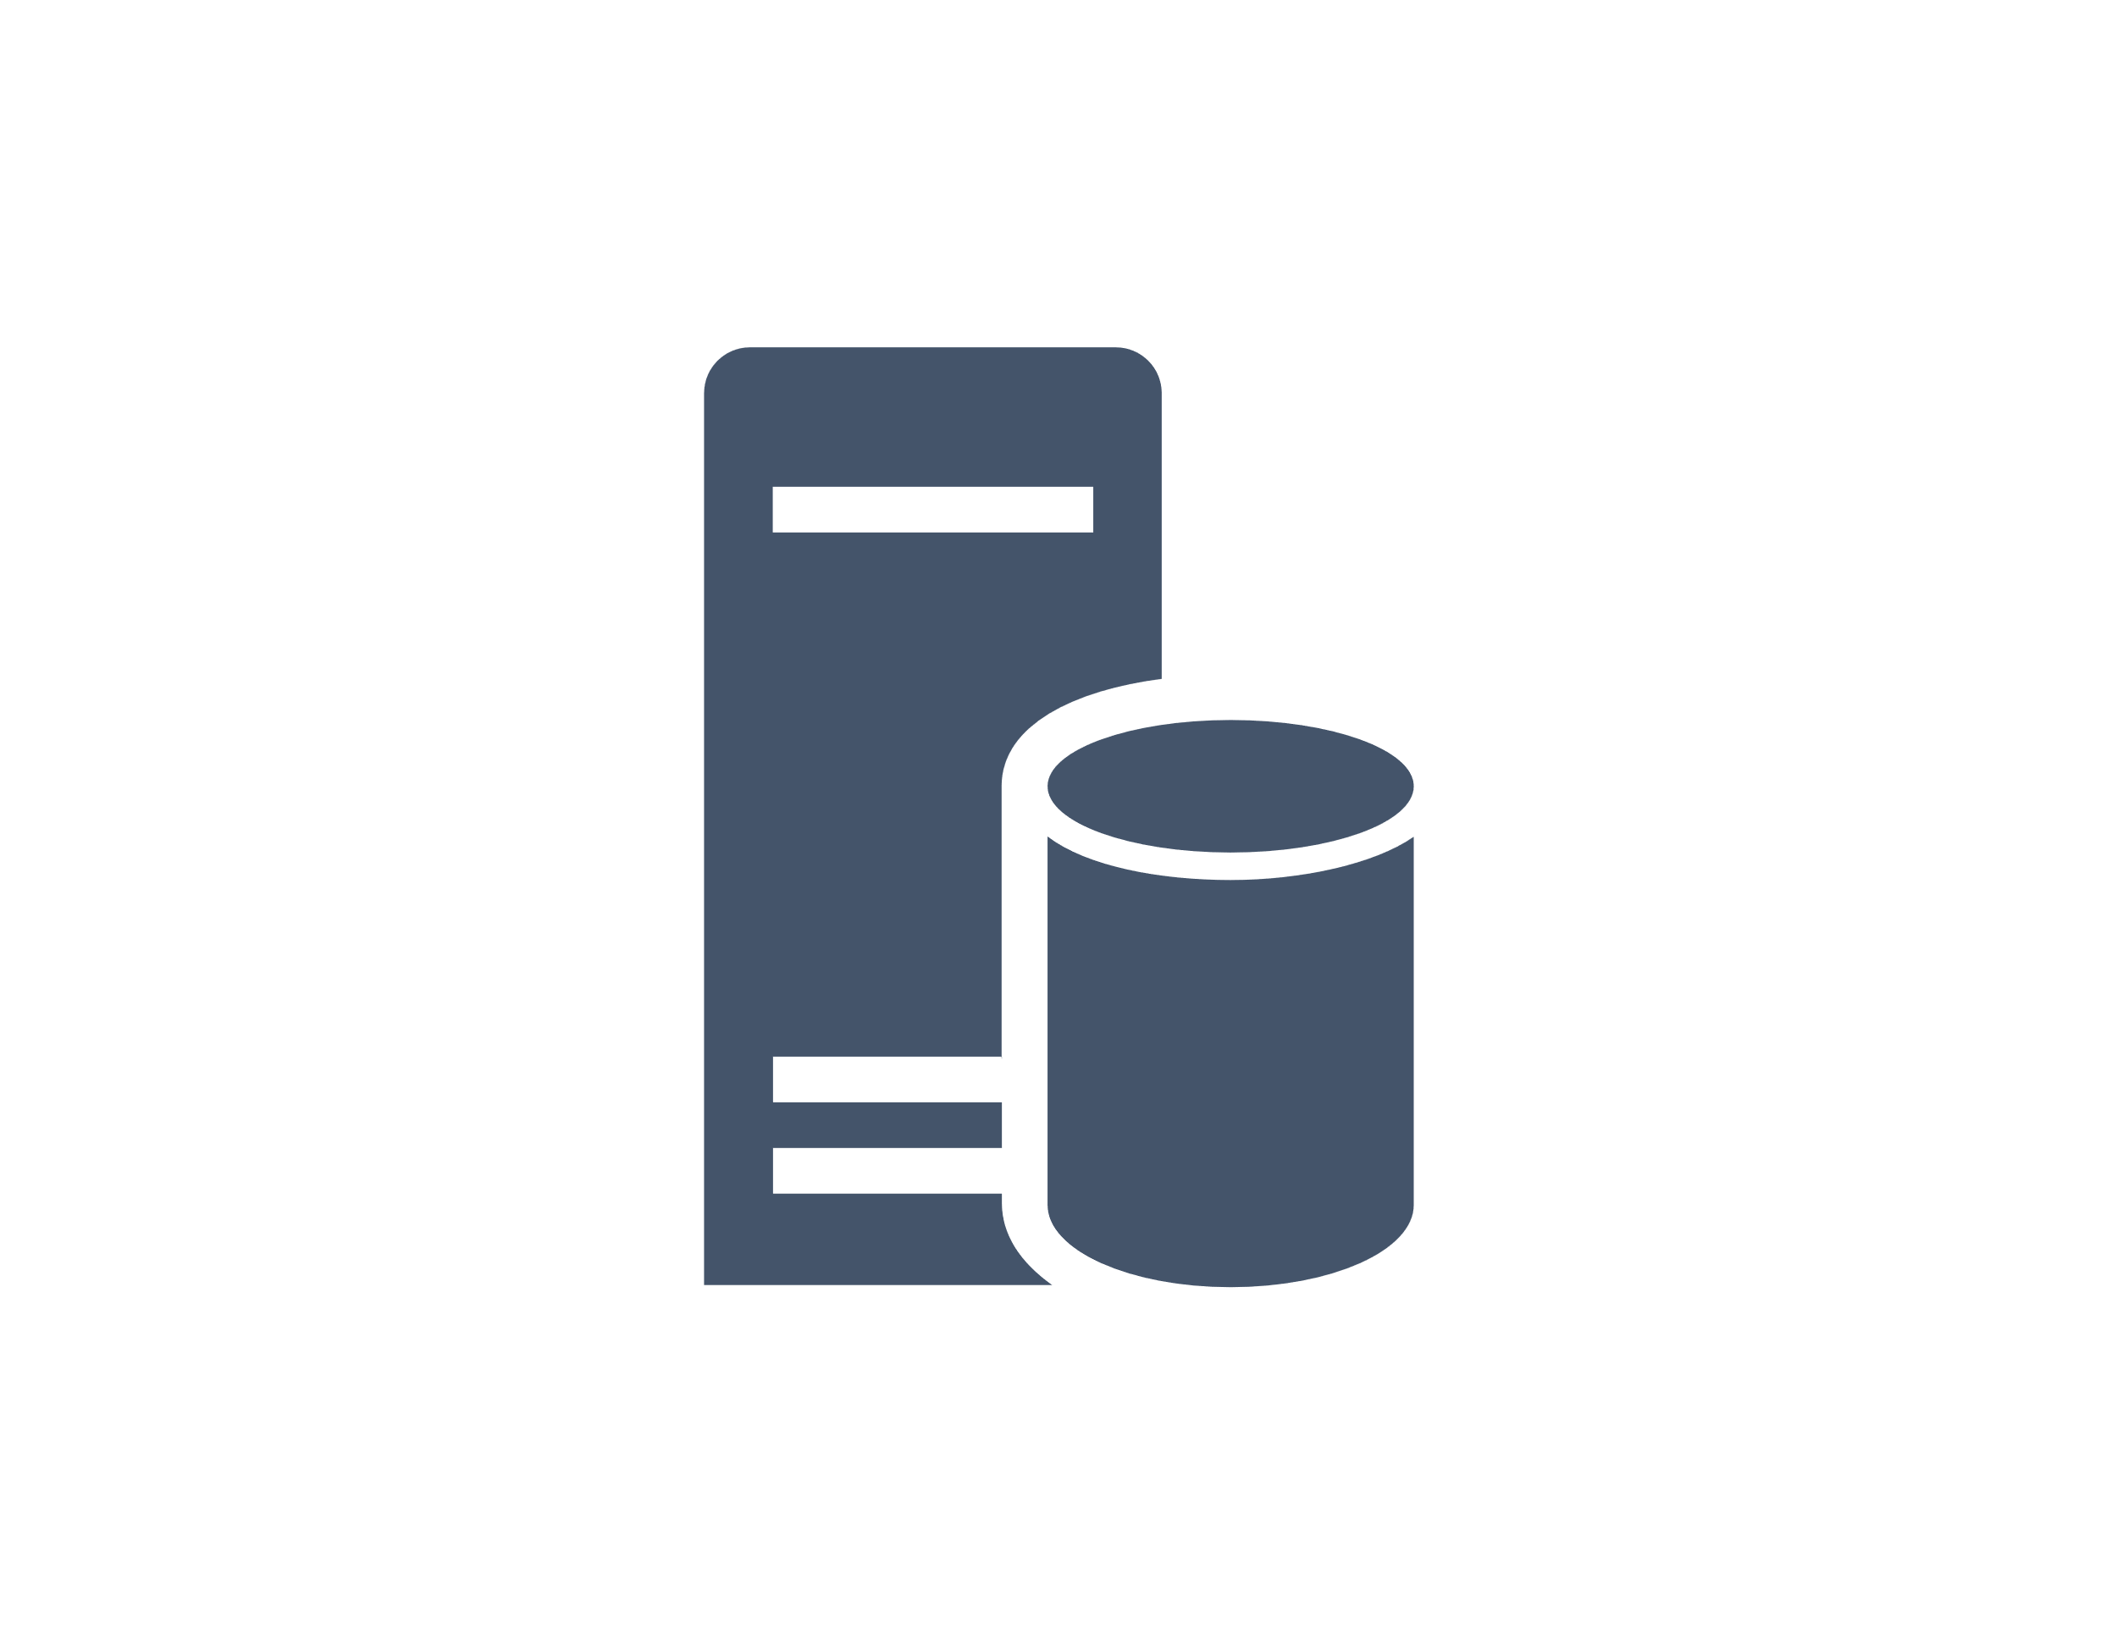
Stretch Database
Dynamically migrate transactional data from SQL Server to Azure SQL Database:
Keep cool data in lower-cost Azure storage
Keep hot data “closer” to your users in local server storage
Compatible with Always Encrypted and Row-Level Security
Notes:
20535A
7: Comparing Database Options in Azure

Slide 7
Elastic Scale
Elastic Scale simplifies the scaling out (or in) of data in Azure SQL Database
Composed of two parts:
An Elastic Scale library for client applications to configure shards and access shards
The Elastic Scale features in Azure SQL Database that implements the any changes requested by your application
Notes:
20535A
7: Comparing Database Options in Azure

Slide 8

Third-Party Databases in Azure
Azure Database for MySQL:
MySQL Community Version
phpMyAdmin Already Installed
Azure Database for PostgreSQL:
Supports PostgreSQL Extensions
Notes:
High compatibility with existing database systems.
Supports current major version and previous two major versions.
Both of the managed database services in Azure share a common set of features:
Built-in high availability with no additional cost.
Predictable performance, using inclusive pay-as-you-go pricing.
Scale on the fly within seconds.
Secured to protect sensitive data at-rest and in-motion.
Automatic backups and point-in-time-restore for up to 35 days.
Enterprise-grade security and compliance.
20535A
7: Comparing Database Options in Azure

Slide 9

Discussion
What strategy would you use to stretch your existing SQL Server data to Azure SQL Database?
Notes:
Answers will wildly vary.
Some organizations keep cool data on-premise since the existing servers are a sunk cost and keep warm data in Azure on geo-replicated instances that are closer to field offices.
Some organizations do the opposite and run Azure SQL Database at the lowest possible performance levels to save money on cool data stored in the cloud.
20535A
7: Comparing Database Options in Azure

Slide 10
Lesson 2: NoSQL Services
Azure Storage Azure Search
Notes:
20535A
7: Comparing Database Options in Azure

Slide 11
Azure Storage
Service in Azure to store various media and files
Blobs
Tables
Queues
Files
Notes:
20535A
7: Comparing Database Options in Azure

Slide 12
Storage Architecture
Import / Export
Client Libraries
(.NET, Java, C++, Android, Node.JS…)
SMB Client
REST
REST
REST
REST
SMB 2.1
Blob/Disk
Endpoint
Table
Endpoint
Queue
Endpoint
File Share
Endpoint
Front End Layer
Massive Scale Out & Auto Load Balancing Index Layer
Partition Layer
Distributed Replication Layer
Stream Layer
Notes:
Focus on how each storage service is exposed as a REST endpoint. The various clients (in RED) all can take advantage of the REST API endpoint.
20535A
7: Comparing Database Options in Azure

Slide 13
Storage Tables
NoSQL database service using the key/value (or Dictionary) design paradigm:
Can be accessed using dedicated clients or OData protocol
Built for massive scale
ODATA
devtable
caleteetstr
SAS TOKEN
TableClient
entities
table
account
Notes:
This is basically a key/value NoSQL database.
The OData protocol sits on top of the (REST API).
SAS Tokens are available to implement the Valet Key pattern.
20535A
7: Comparing Database Options in Azure

Slide 14
Migration to Cosmos DB
All existing Storage Accounts are migrating to Cosmos DB:
Existing applications can migrate to Cosmos DB with no code changes
The Cosmos DB Tables API introduced new features not found in standard Storage:
Turnkey global distribution
Dedicated throughput worldwide
Single-digit millisecond latencies at the 99th percentile
Guaranteed high availability
Automatic secondary indexing
Notes:
20535A
7: Comparing Database Options in Azure

Slide 15
Azure Search
Search-as-a-Service:
Delegates server and infrastructure management to Microsoft
Immediately ready-to-use service that you populate with search data, and then access from your application:
Accessible via REST APIs or Client SDKs
Standard search is fully scalable, with options to increase storage or service replicas for handling larger query loads
Notes:
20535A
7: Comparing Database Options in Azure

Slide 16
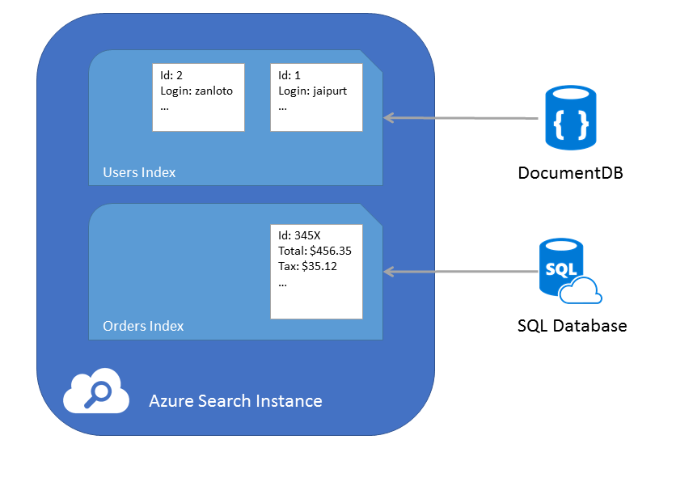
Azure Search Indexers
Search can index existing data stores including:
CosmosDB DocumentDB API
Azure SQL Database
Notes:
The indexers can add documents to individual indexes.
20535A
7: Comparing Database Options in Azure

Slide 17
Time Series Insights
Manages IoT time-series data stored in the cloud:
End-to-end service that manages:
Analytics
Storage
Visualization
Designed for terabytes of time-series data
Integrates with IoT Hubs to ingest data
Notes:
The service replaces 3-4 services that would normally perform the same functionality.
20535A
7: Comparing Database Options in Azure

Slide 18
Lesson 3: Azure Cosmos DB
Cosmos DB Consistency Levels
Notes:
20535A
7: Comparing Database Options in Azure

Slide 19





Cosmos DB
SQL
Azure Cosmos DB
Key-Value
Column-family
Documents
Graph
Global distribution
Elastic scale out
Guaranteed low latency
Five consistency models
Comprehensive SLAs
Globally distributed multi-model database engine
Notes:
A globally-distributed, multi-model database service:
First party and popular third-party OSS APIs.
Key-value, Document, Columnar, and Graph.
DocumentDB (SQL and JavaScript), MongoDB, Table, and Gremlin.
Supported across number of programming languages.
More APIs to be added.
20535A
7: Comparing Database Options in Azure

Slide 20
Global Distribution
Mission-critical applications for a global userbase need …
Global distribution
Fast, Responsive millisecond latency
Elasticity of compute and storage
Durable, Consistent and Highly available
Notes:
Worldwide presence
Automatic multi-region replication
Multi-homing APIs
Manual and automatic failovers
Latency, throughput, consistency, and availability guarantees
20535A
7: Comparing Database Options in Azure

Slide 21
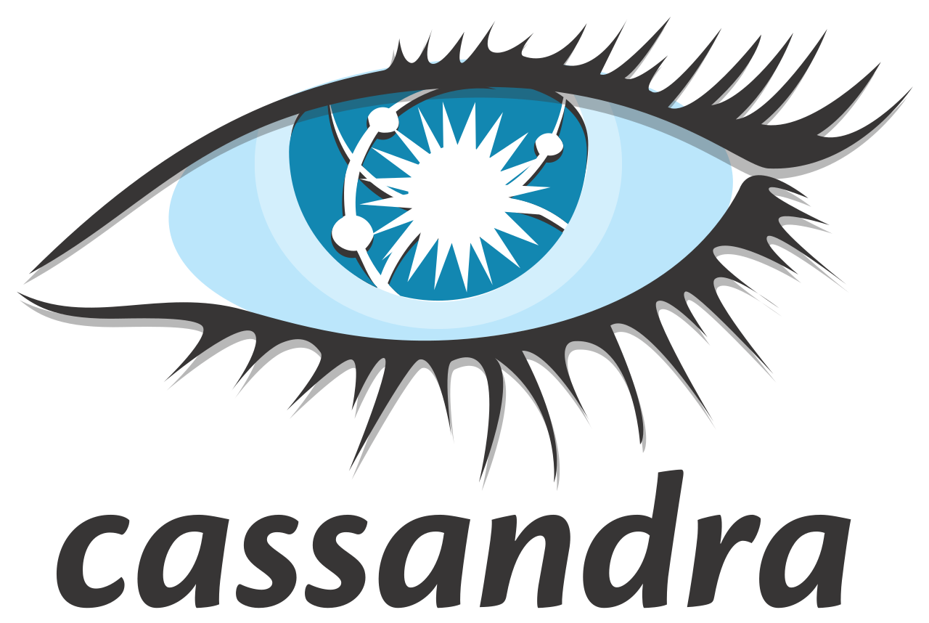
APIs
Core Database
Column-family
Key-Value
Graph
Documents
SQL
Notes:
The core database “surfaces” various models and then each model can be accessed using a well-known API such as:
Cassandra
MongoDB
DocumentDB (SQL/JS)
Azure Storage Tables (Key/Value)
20535A
7: Comparing Database Options in Azure

Slide 22
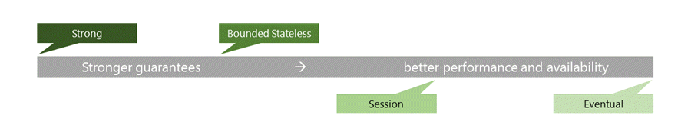
Consistency Levels
The consistency levels range from:
Strong consistency where reads are guaranteed to be visible across replicas before a write is fully committed across all replicas
Eventual consistency where writes are readable immediately and replicas are eventually consistent with the primary
Notes:
Talk about the performance differences between Strong and Eventual consistency:
Global distribution forces us to navigate the CAP theorem.
Writing correct distributed applications is hard.
Five well-defined consistency levels.
Intuitive and practical with clear PACELC tradeoffs.
Can be overridden on a per-request basis.
Refer students to their books for a full chart detailing every consistency level.
20535A
7: Comparing Database Options in Azure

Slide 23
Throughput
Each collection is assigned a performance level and that performance level dictates throughput for that collection and its corresponding documents:
If a particular collection is seeing spikes in throughput, you can manage it’s performance level in isolation by increasing or decreasing the performance level. This change to the performance level of a particular collection will not cause side effects for the other collections. This allows you to adjust to meet the performance needs of any workload in isolation.
Notes:
Pay by the hour, only what you need.
No partition management, no limits.
Change throughput at any time, effective in seconds.
Scale from 100 to 100s of millions of requests/sec across any number of regions.
Now supports requests/min to handle spikes cost-effectively.
20535A
7: Comparing Database Options in Azure

Slide 24
Discussion
What are some business scenarios where you would want to use more than one Cosmos DB API?
Notes:
20535A
7: Comparing Database Options in Azure

Slide 25
Lesson 4: Data Storage & Integration
Data Storage & Integration Options Data Integration
Notes:
20535A
7: Comparing Database Options in Azure

Slide 26
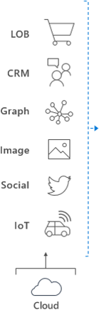

Data Storage & Integration Options
Ingest
Store
Prep & Train
Model & Serve
Data orchestration and monitoring
Big data store
Hadoop/Spark and Machine Learning
Data warehouse
Notes:
We will briefly touch on some of the data services that compose an end-to-end big data solution hosted on Azure.
Remind students that data in the cloud is covered in more depth in other Azure courses.
20535A
7: Comparing Database Options in Azure

Slide 27
SQL Data Warehouse
Model data from various sources:
Data can be ingested from sources including:
IoT
Devices
CRM
Graph Database
APIs
Other Databases
Notes:
20535A
7: Comparing Database Options in Azure

Slide 28
SQL Data Warehouse
Query and serve data to your workloads and applications:
You can query data from Data Warehouse using PolyBase
PolyBase uses T-SQL language
Data stored on well-known platform:
Data is stored, partitioned and managed using compute infrastructure nodes backed by Azure Storage
Notes:
20535A
7: Comparing Database Options in Azure

Slide 29
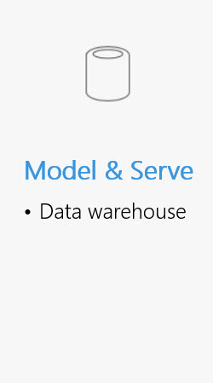
SQL Data Warehouse
Store
Query
Relational Tables Columnar Storage
PolyBase T-SQL
Notes:
Data is ingested into big-data storage from many sources including devices, IoT, social, business applications and graph databases.
SQL Data Warehouse stores data into relational tables with columnar storage.
Once we are ready for more complex analysis, we can use PolyBase in Azure SQL Data Warehouse to perform advanced queries on the data. PolyBase uses a standard T-SQL syntax.
20535A
7: Comparing Database Options in Azure

Slide 30
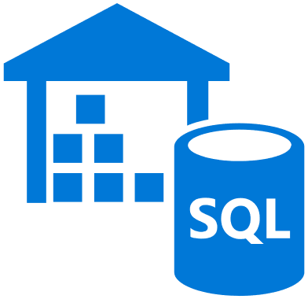


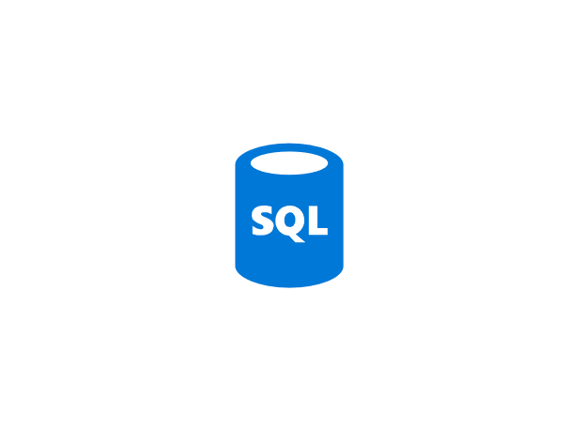

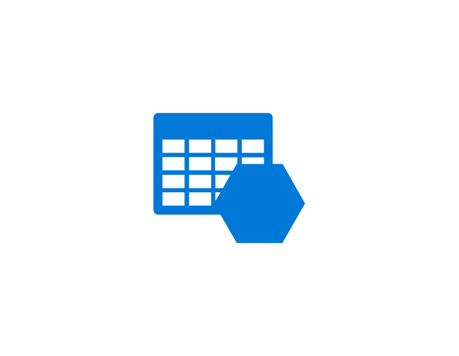

SQL Data Warehouse
Application or User
Control Node
Massively Parallel Processing (MPP) Engine
DMS
DMS
DMS
DMS
Compute Node
Compute Node
Compute Node
Compute Node
Azure Storage
Notes:
Azure SQL Data Warehouse is built on top of a “scale-out” architecture.
This enables distributed computational processing across a wide quantity of nodes.
DWU (Data Warehouse Units) or the unit of scale.
20535A
7: Comparing Database Options in Azure

Slide 31
Data Lake
Integrate a wide variety of data stores into existing workloads and applications:
Ideal for large volume scenarios that require high speed analysis and access
Store various business data stores in a centralized location:
Search and analyze the data using a single platform a U-SQL
Notes:
20535A
7: Comparing Database Options in Azure

Slide 32



Data Lake
Azure Data Lake
Analytics
U-SQL
YARN
Storage
WebHDFS
Unstructured
Semi-Structured
Structured
Notes:
Azure Data Lake is composed of two primary components: Analysis and Storage:
Analysis: Azure Data Lake uses well-known standards (like Apache Storm, Spark and Hadoop) for Analytic workloads. There is also a new data language (U-SQL) specifically designed for Azure Data Lake.
Storage: Azure Data Lake has a custom storage tier that supports a mixture of both structured and unstructured data.
The two tiers communicate using the Web HDFS (Java API) standard. YARN (Hadoop job manager) manages the running jobs for any analytic workloads.
20535A
7: Comparing Database Options in Azure

Slide 33
Data Lake
New language designed specifically for Azure Data Lake:
Combines best parts of SQL and C#
Can process any data type even without schemas
Can be used to write expressive custom code using C# syntax
U-SQL
C#
SQL
Notes:
20535A
7: Comparing Database Options in Azure

Slide 34
Data Integration
Azure Data Factory:
Compose data processing, storage and movement services to create & manage analytics pipelines
Originally focused on Azure & hybrid movement to/from on premises SQL Server:
Over time, expanded to more storage & processing systems throughout
End-to-end pipeline monitoring and management
Notes:
This is an alternative to traditional SSIS packages.
20535A
7: Comparing Database Options in Azure

Slide 35
Data Factory
Each Data Factory Solution is composed of four key components
Connect & Collect
Publish
Monitor
Transform & Enrich
Notes:
Azure Data Factory is a cloud-based data integration service that allows you to create data-driven workflows in the cloud for orchestrating and automating data movement and data transformation.
20535A
7: Comparing Database Options in Azure

Slide 36










Data Factory
Connect & Collect
Publish
Monitor
Transform & Enrich
Relational Data
Non-relational Data
Notes:
Collect from various data sources.
Transform using tools like: Apache Spark, Hadoop (or HDFS), databases (such as Cassandra, Cosmos or Mongo).
Publish to Applications and BI Platforms.
Monitor using SDKs or Azure Monitor.
20535A
7: Comparing Database Options in Azure

Slide 37





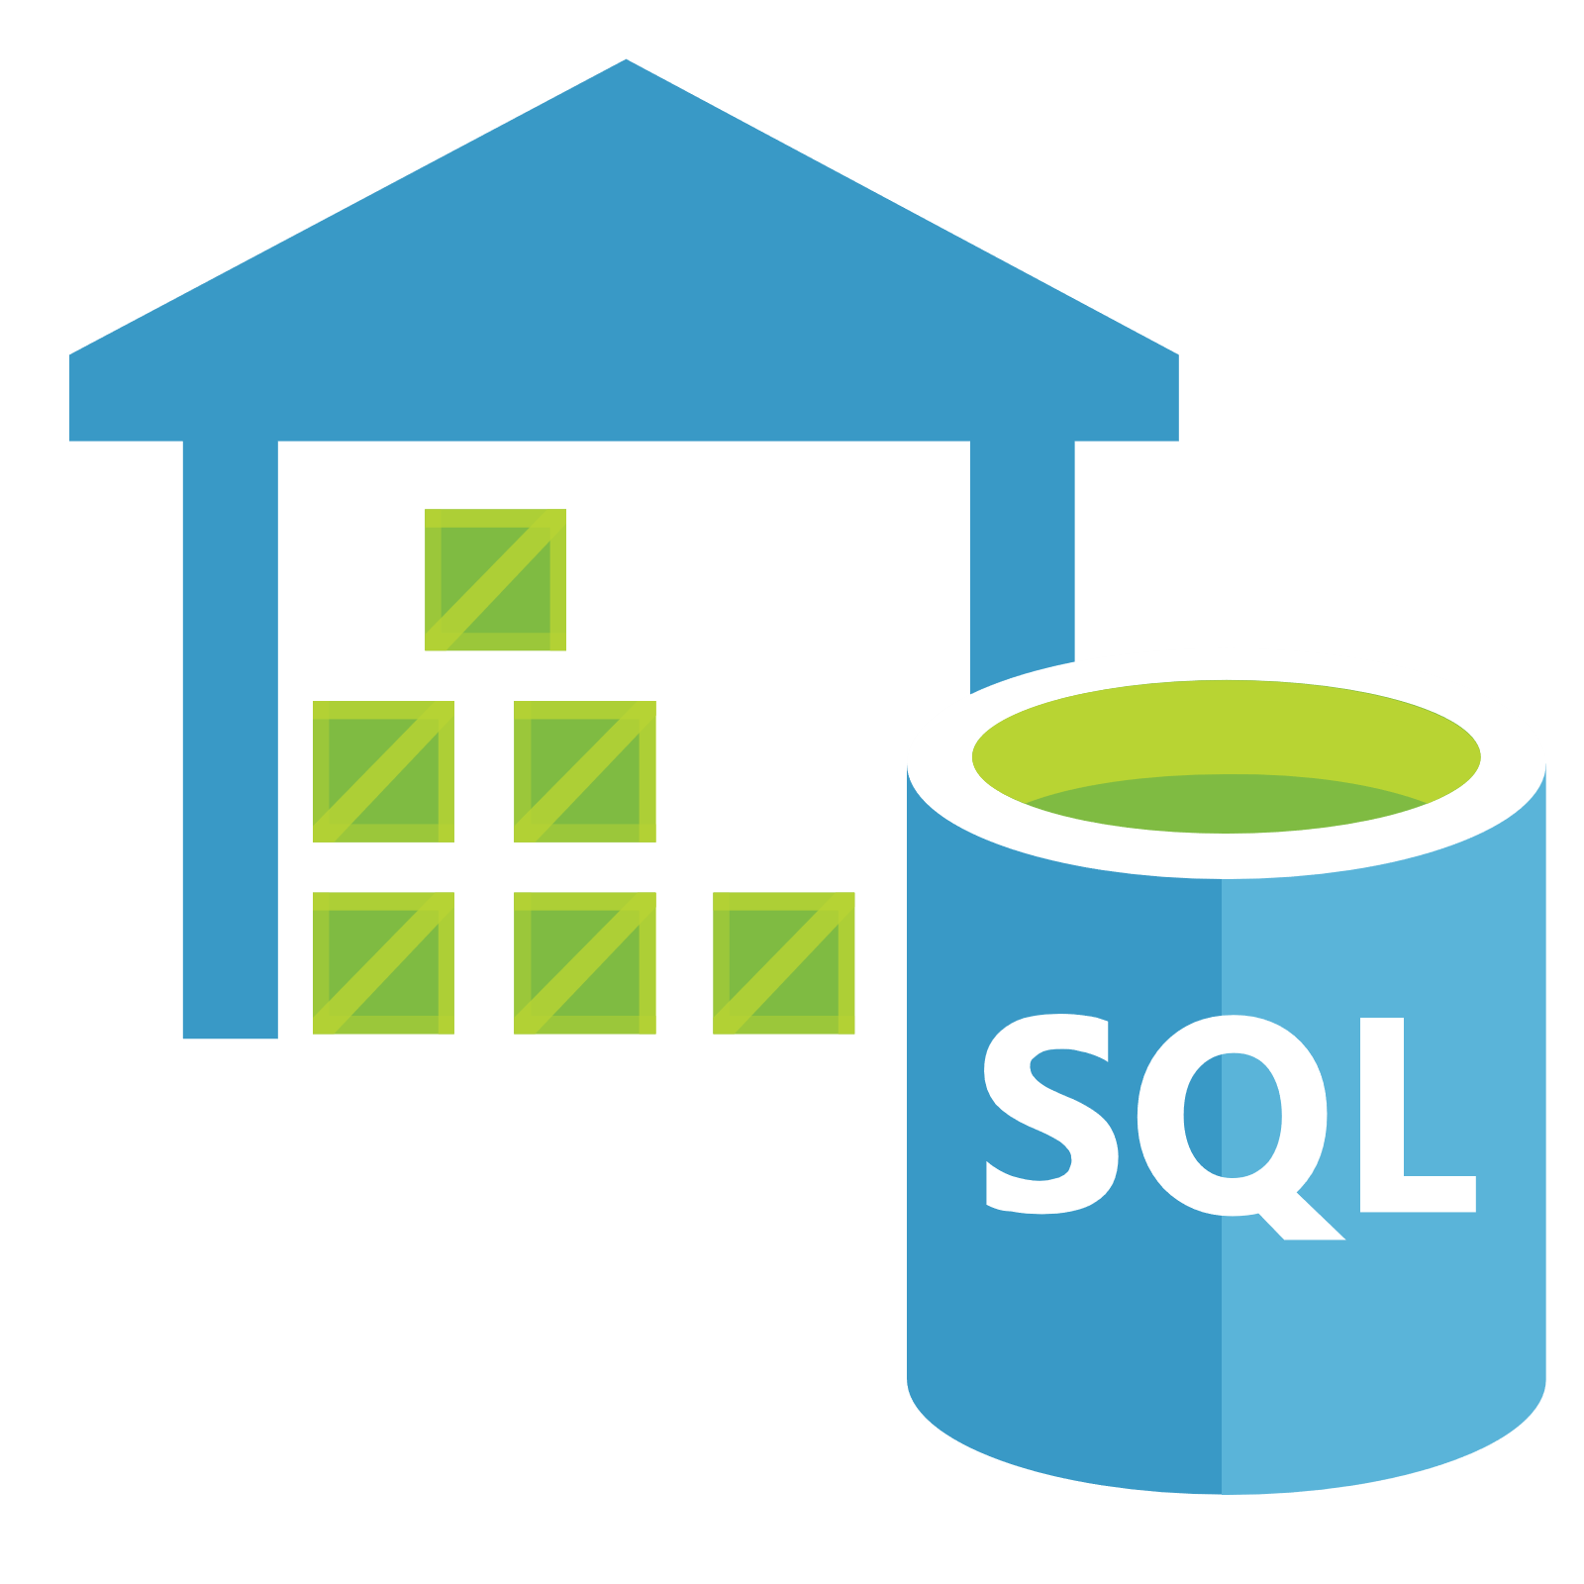



Data Factory
Azure Data Factory is an option to migrate data from Azure Data Lake to Azure SQL Data Warehouse
Azure Data Lake Analytics
Relational Database
Web Portal
Azure SQL Data Warehouse
HDFS Cluster
Interactive Analytics
Azure Data Lake Store
Power BI
Streaming Data
Azure Data Factory
Notes:
Data stored in ADL Store can be cleansed and cooked using ADL Analytics before being migrated to Azure SQL DW using Data Factory.
20535A
7: Comparing Database Options in Azure

Slide 38
Lesson 5: Data Analysis
Data Analysis Options
Notes:
20535A
7: Comparing Database Options in Azure

Slide 39
Data Analysis Options
Analysis Services:
Enterprise BI-as-a-Service
Increases efficiency of queries:
Complex raw data is optimized “behind the scenes” for search and processing
DirectQuery-caliber speeds are achievable on many data sources
Easier for users to surface data:
Data is surfaced in user-friendly business models
Users can use well-known tools, like Excel or Power BI, to query the models
Notes:
20535A
7: Comparing Database Options in Azure

Slide 40
















Analysis Services
Data Sources
Cloud
Security
Client Tools
SQL Database
In-Memory Cache
Cloud
SQL Data Warehouse
Data Modeling
Power BI
Data Lake
HDInsight/Spark
On-Premises
Other
Azure Analysis Services
Lifecycle Management
Business Logic & Metrics
Third-Party
On-Premises
Power BI Desktop
SQL Server/Oracle
Excel
Other
Notes:
Azure Analysis Services can be built “on top” of a petabyte-scale SQL Data Warehouse and Azure HDInsight Spark implementation. Tools, both cloud and on-premises, can be used to query the data using Analysis Services.
20535A
7: Comparing Database Options in Azure

Slide 41
HDInsight
Three Core Focuses:
Elastic:
Store any type of data you like (structured or unstructured)
Store when or how you like
Simple:
You should be able to create a Hadoop cluster in three minutes
Secure:
Instances are isolated by default
Built-on top of Azure Storage and Azure IaaS which both have well-known security best practices
Notes:
20535A
7: Comparing Database Options in Azure

Slide 42
HDInsight
Build your solutions on Hadoop:
Storage + proliferation of compute models for data processing at scale
Began life as an open source implementation of Google’s Map/Reduce and GFS papers
In use at many major web companies at massive scale (1000s of node, PB’s of storage)
Notes:
20535A
7: Comparing Database Options in Azure

Slide 43





HDInsight
Big data processing on top of Azure Storage
Shape
Acquire
Query
Publish
Experiment
Azure Storage
Notes:
20535A
7: Comparing Database Options in Azure

Slide 44
HDInsight
Authoring Jobs
App Integration
End User Tooling (IDE’s, Analyst tools, Command lines)
Extend breadth & depth
Enable new scenarios
Integrate with current tool chains
Lightweight
Low cost to extend
Scenario oriented
Breadth of Clients (Java, JS, .NET, etc.)
Consistent REST API’s
Connectivity
Programmability
Security
Loosely coupled
Innovation flows upward
New compute models
Perf enhancements
Core Hadoop
Authoring frameworks and languages
Notes:
20535A
7: Comparing Database Options in Azure

Slide 45
HDInsight
Sentiment Analysis
Clickstream Processing
Machine/Sensor
Server Logs
Geo-Location
Finance
Telco
Retail
Manufacturing
Transportation
Web
Prevent
Securities fraud
Compliance violations
Security breaches
Network outages
---
Machine failures
Driver & fleet issues
Application failures
Operational issues
Monitor real-time data to…
Optimize
Order routing
Pricing
Bandwidth allocation
Customer service
Offers
Pricing
Routes
Pricing
Site content
Supply chain
Notes:
20535A
7: Comparing Database Options in Azure

Slide 46
HDInsight
You can use Azure Data Lake with an Azure HDInsight cluster
Map reduce
Hive query
HBase transactions
Spark queries
Any Other HDFS Application
Azure HDInsight
Hadoop WebHDFS Client
Azure Data Lake Store
WebHDFS-compatible REST API
Notes:
20535A
7: Comparing Database Options in Azure

Slide 47
Data Catalog
Surfaces enterprise data for workloads and ad-hoc queries:
Employees can find data sets that are normally difficult to find
Data Assets can be shared among enterprise applications
Control and delegate access to data assets
Integrate data assets into existing processes using REST APIs
Notes:
The term “tribal knowledge” if often used here to describe data assets that are often only known by a few employees and needed by many employees. This tool is designed to democratize data access so that any employee can ad-hoc query appropriate data sets with minimal IT involvement.
20535A
7: Comparing Database Options in Azure

Slide 48
Data Catalog
Discover
Browse
Filter
Understand
Metadata
Experts
Consume
Data Assets
Familiar Tools
Search
Context
Existing Processes
Contribute
Tag
Document
Publish
Extend
Notes:
Many existing solutions in our companies do one or more of these tasks, but they typically take a lot of effort or time. Data Catalog extends our existing data assets with these features with a reduced amount of effort.
20535A
7: Comparing Database Options in Azure

Slide 49
Lesson 6: Web Apps & SQL Case Study
Case Study Overview Case Study Solution
Notes:
20535A
7: Comparing Database Options in Azure

Slide 50
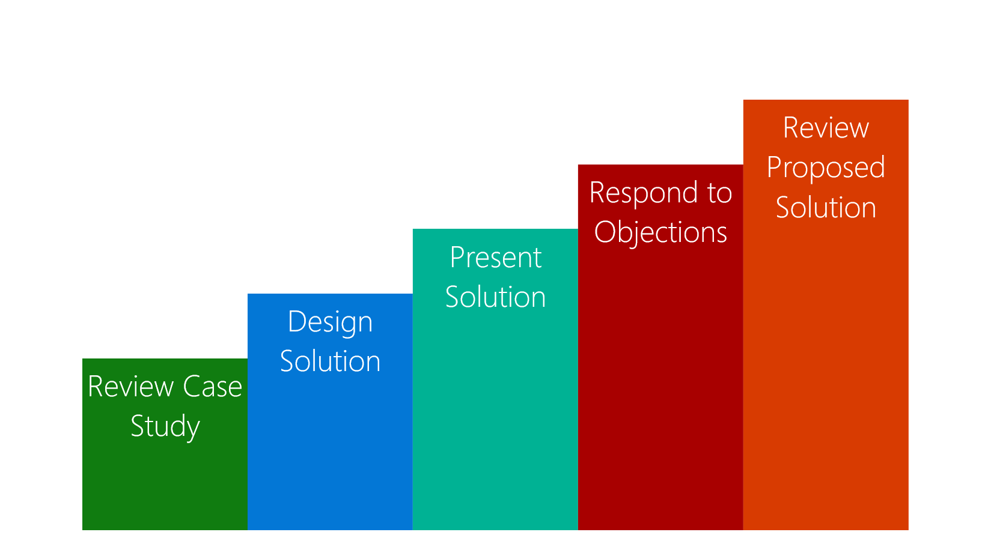
Case Study Overview
Review the case study requirements
Design a solution to the customer business problem
Present your solution
Respond to questions and objections
Review a potential solution
Notes:
Review the “Case Study Flow.”
20535A
7: Comparing Database Options in Azure

Slide 51
Customer Business Problem
Boutique Manufacturer of high-quality bicycles and parts:
One of the world’s largest makers of premium race and commuter bicycles
Mission:
To passionately pursue advanced, innovative technologies that help cyclists of all abilities find more enjoyment in the sport
Manufactures and Sales:
Bicycles
Bicycle Parts
Bicycle Accessories
Notes:
Founded in 1954, Adventure Works Cycles has grown from a boutique manufacturer of high-quality bicycles and parts into one of the world’s largest makers of premium race and commuter bicycles. The Adventure Works mission has remained the same: to passionately pursue advanced, innovative technologies that help cyclists of all abilities find more enjoyment in the sport.
20535A
7: Comparing Database Options in Azure

Slide 52
Customer Business Problem
Data-center:
As of 2009, most IT infrastructure is located in an on-site datacenter (Provo, Utah)
Also has servers hosted in a third-party collocated datacenter
Costs USD $30,000 - $40,000 per month
Servers located throughout the United States
Capacity:
Most applications and databases run on underutilized hardware
Data scattered throughout multiple geographic locations
Notes:
During the global recession of 2009, most of the company’s IT infrastructure was located in the company’s Provo, Utah, headquarters, but Adventure Works also had a sizable third-party colocation datacenter, costing US$30,000 to $40,000 a month, and other servers scattered around the United States.
20535A
7: Comparing Database Options in Azure

Slide 53
Customer Business Problem
Other Brand:
Tailspin
Goals:
Upcoming hardware refresh = significant capital expenditure
Looking to eliminated the costly and risky refresh cycles
Notes:
Adventure Works Cycles Company manufactures and sells bicycles, bicycle parts, and bicycle accessories under the Adventure Works Cycles and Tailspin brands worldwide.
Adventure Works knows that its datacenters are filled with dozens of smaller web servers and databases that run on underutilized hardware, and it has customer data scattered in multiple places. Faced with the prospect of a very large capital expenditure owing to the fact that the vast majority of their servers are now due for a hardware refresh, Adventure Works is looking for other options that eliminate the costly and high risk hardware refresh cycles.
20535A
7: Comparing Database Options in Azure

Slide 54
Customer Inventory
Existing Applications
Product Catalog
Inventory
Departmental
Notes:
In reviewing all of Adventure Works’ web applications, it was determined that there were three archetypical database backed web applications present:
Product Catalog: Resellers and consumers in North America, Asia and Europe access the product catalog via a website, the data for which is currently stored in SQL Server. Currently, both web site and database are hosted in its Utah datacenter. The database is 50GB in size, and is not expected to grow past 100GB.
Inventory: The inventory web application is a mission critical system primarily used by operations running in North America. Currently, both web site and SQL Server database are hosted in its Utah datacenter. This is Adventure Works' largest database at 3 TB in size, but it is not expected to grow beyond 5 TB.
Departmental: These web applications support the regional offices only. Both web site and database are hosted in the Utah data center. While individually these have web applications have low demands and data sizes in the 500MB-1GB range, Adventure Works has 100’s of SQL Server databases supporting the numerous web apps, and fully expects new databases to be created to support departmental efforts.
Most of Adventure Works developers are already trained in Microsoft tools as all of Adventure Works' web applications and services are built using .NET. Additionally, they have already deployed Active Directory and are currently using a replicated directory in support of departments within each regional office.
20535A
7: Comparing Database Options in Azure

Slide 55
Customer Goals
Migration: Migrate databases, services and web applications to Azure
Performance: Achieve high performance for internal customers in Japan and China
Ease of Use: Would like to avoid the challenges of setting up geo-replicated infrastructure manually
Notes:
Not only are all the servers expensive to acquire and maintain, but scaling the infrastructure takes significant time. “During and after a high-profile race, there’s a great deal of interest in our product, and our websites receive a lot of hits,” says Hayley Leigh, Manager of Solution Development for Adventure Works Cycles. “It is difficult to scale our web hosting environment fast enough, and consumers and resellers could experience slow response times and even downtime.” Another challenge: Adventure Works conducts weekly server hardware maintenance, which causes downtime for some of its global offices.
Adventure Works wants to move many consumer-facing websites, enterprise databases, and enterprise web services to Azure. “By using Microsoft global datacenters, we’re able to move infrastructure for key applications and websites closer to the people who use them,” Leigh says. A big problem for Adventure Works is resellers and consumers in Japan and China have to use applications that run in a Utah datacenter, and because of the distance, encounter performance problems. Adventure Works would like to resolve this without the difficulty, expense and time requirements incurred by setting up infrastructure on the other side of the world using Adventure Works-owned servers.
20535A
7: Comparing Database Options in Azure

Slide 56
Customer Needs
Improve the performance for customers and resellers accessing its websites around the world
Support for easily provisioning resources to meet bursts of demand
Consolidate and improve the utilization of website and database hosting resources
For their most demanding databases, they want to migrate without having to re-architect their database structure or make large changes the application
Avoid downtime, particularly that caused by web and database server patching
Leverage familiarity with Microsoft tools
Notes:
20535A
7: Comparing Database Options in Azure

Slide 57
Customer Objections
Scale & Performance:
I do not want to have to make code changes (or re-deploy) in order to change the scale of a website
I hear Azure Web Sites is only useful for websites with small amounts of traffic; will it really support the heavy traffic we receive?
We would prefer to avoid performing a database migration (e.g., to another server) in order to scale the throughput of our database
We have heard SQL Database does not provide consistent performance, is this true?
Notes:
20535A
7: Comparing Database Options in Azure

Slide 58
Customer Objections
Business Continuity:
How can we certain our data will survive in the event of a catastrophe in a certain part of the world?
We need to be able to recover from mistakes made by administrators that accidentally delete production data (we know they happen, we would love an “undo”)
Do we need to have multiple web server instances for each property to have a high SLA?
Notes:
20535A
7: Comparing Database Options in Azure

Slide 59
Customer Objections
Tool Familiarity:
Will we need to learn new tools to develop for Azure Websites and SQL Database?
What about diagnosing problems? Are there new tools we need purchase and learn?
Connectivity:
Some of our enterprise web services need to access data and other services located on-premises, is this supported?
How can we ensure we are delivering the lowest latency possible to our website visitors?
We need to ensure that if we have multiple web servers backing a given website, that no one web server gets all the traffic
Notes:
20535A
7: Comparing Database Options in Azure

Slide 60
Customer Objections
Management:
We would prefer not to have to manage patching of web servers and databases
With all of our websites and databases around the world, how do we keep tabs on which is up and which is down and which is struggling?
We need a simple solution to schedule and automate backup of the website and database
Notes:
20535A
7: Comparing Database Options in Azure

Slide 61
Customer Objections
Security:
Is it possible to allow our visitors to use a mix of legacy and modern browsers and still provide for secure transactions?
What does Azure offer to help us with auditing access to our web servers and databases?
Our staff is accustomed to accustomed to a single sign-on experience — will this still be possible?
Notes:
20535A
7: Comparing Database Options in Azure

Slide 62
Call to Action
Case Study Timing: 60 Minutes
Who are the business decision makers and stakeholders?
What customer business needs do you need to address with your solution?
Diagram your proposed solution
Notes:
20535A
7: Comparing Database Options in Azure

Slide 63
Case Study Solution
Target Audience
Potential Solution
Benefits
Customer Quote
Notes:
20535A
7: Comparing Database Options in Azure

Slide 64
Target Audience
Hayley Leigh, Manager of Solution Development
Business Decision Makers
Technical Decision Makers
Manager of Solution Development
Infrastructure Managers
Application Sponsors
Business Unit IT
Developers
Notes:
Hayley Leigh, Manager of Solution Development for Adventure Works Cycles.
The primary audience is the business decision makers and technology decision makers. From the case study scenario, this would include the Manager of Solution Development. Usually we talk to the Infrastructure Managers who report into the CIO’s, or to application sponsors (like a VP LOB, CMO) or to those that represent the Business Unit IT or developers that report into application sponsors.
20535A
7: Comparing Database Options in Azure

Slide 65
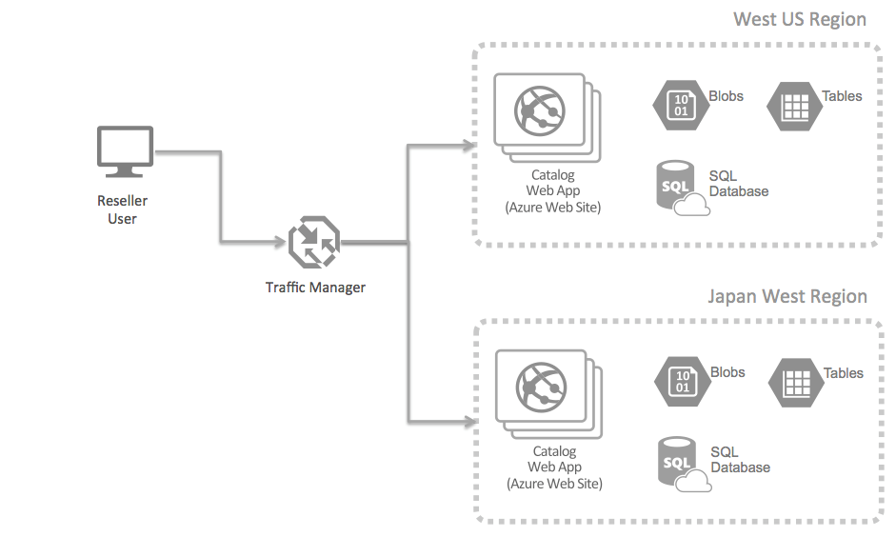
Potential Solution
Web Application Hosting
Notes:
The PoC scenario would be to address the latency issue faced by resellers around the world that currently rely on to access the Utah datacenter. The PoC would address showing how by using Azure Traffic Manager along with Azure Web Sites in multiple regions, one can ensure that these users are always being routed to the Web Site that is “closest” to them in terms of minimizing network latency. The PoC could demonstrate this by provisioning a representative portion of the Product Catalog web application in an Azure Website, along with the storage required for it (e.g., Blob Storage, Table Storage and SQL Database) in the West US region, and then also provisioning the same infrastructure in the Japan West region. Traffic Manager would then be configured to route traffic using the Performance load balancing method.
To complete the PoC, either Adventure Works staff or resellers located near each region could be asked to visit the PoC reseller web site, measure their experience (e.g., page load times, time to first paint, etc.) and report on the perceived performance (e.g., does it feel more responsive than the current site?).
20535A
7: Comparing Database Options in Azure

Slide 66
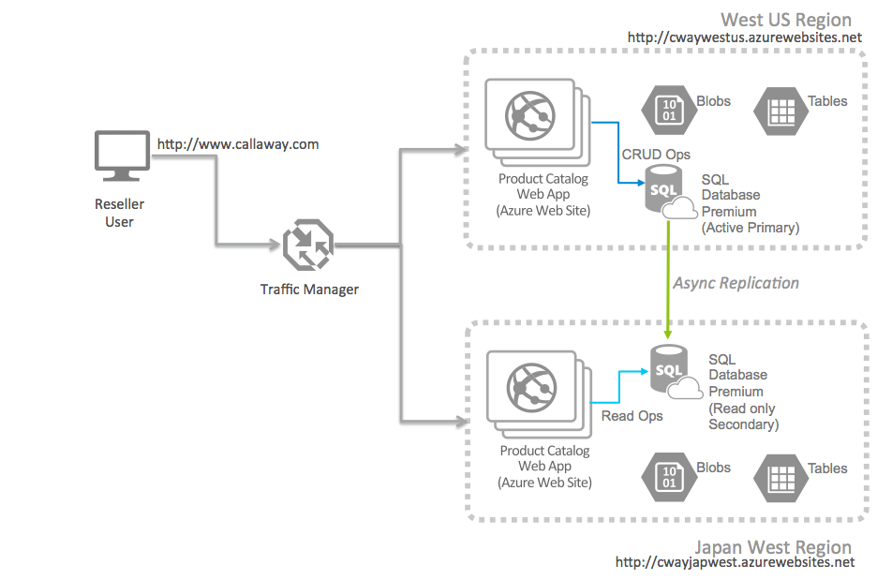
Potential Solution
Database Queries & Sync
Notes:
On the database side, the PoC should be augmented to use the SQL Database Premium tier. The PoC would address showing using SQL Database Premium along with Azure Web Sites in multiple regions, whereby one configures SQL Database Premium to provide Active Geo-Replication across two regions (West US and Japan West as examples). SQL Database Premium could be configured with the primary in the West US Region, and a readable replica available in the Japan West Region.
By approaching it this way, the PoC could explore the benefits of accessing read-only data from the database nearest the Web Site, while reserving data modifications operations for the active primary database instance.
To complete the PoC, Adventure Works could simulate a regional failure and switch to using the SQL Database in the Japan West region as the active primary. They could go one step further and stop the Web Sites in the West US region and thereby simulate a complete regional failure of the West US region. By having Traffic Manager in place, all traffic would flow to the Japan West Region, and the active database would be in that region as well.
20535A
7: Comparing Database Options in Azure

Slide 67
Benefits
By integrating Microsoft cloud solutions into its datacenter strategy, Adventure Works Cycles has been able to reduce IT costs by more than $300,000 a year while gaining greater datacenter scalability and datacenter agility. The IT team can respond to server requests in hours instead of months and “turn off” servers when they are no longer needed.
Notes:
By integrating Microsoft cloud solutions into its datacenter strategy, Adventure Works Cycles has been able to reduce IT costs by more than $300,000 a year while gaining greater datacenter scalability and datacenter agility. The IT team can respond to server requests in hours instead of months and “turn off” servers when they are no longer needed.
20535A
7: Comparing Database Options in Azure

Slide 68
Benefits
With servers running in Microsoft datacenters around the world, Adventure Works can provide better application performance and availability to offices and customers that are located far from the company’s California datacenter
Notes:
With servers running in Microsoft datacenters around the world, Adventure Works can provide better application performance and availability to offices and customers that are located far from the company’s California datacenter.
20535A
7: Comparing Database Options in Azure

Slide 69
Benefits
Scalability & Agility:
Can respond to requests and implement features much quicker than in the past
Easy to setup infrastructure in other geographies
Performance & Availability:
Avoid maintenance-related downtime
Update regional servers in isolation from other global locations/offices
Notes:
Improve Scalability and Agility
Adventure Works has gained a level of IT scalability and agility that it never before had.
Cowles’s team can respond much faster to requests for IT resources. “With Azure, we can respond to business requests in hours versus the months that it took before,” Cowles says. “It’s especially valuable in responding to requests in non-US regions, because it’s difficult to set up infrastructure in Carlsbad and provide remote access to those applications.”
Enhance Performance and Availability of Core Business Systems
Since moving important pieces of its infrastructure to Azure, Adventure Works has enjoyed higher overall availability of critical applications and web properties. “With Azure, we no longer have maintenance-related downtime that negatively affects our business around the world,” Cowles says.
By migrating its business-to-business website to Microsoft Azure, Adventure Works will eliminate the cost of that on-premises infrastructure and also realize reliability and performance gains. “It’s a lot easier to load-balance virtual machines in Azure than physical servers in our datacenter,” Cowles says. “We can also mitigate the impact of server security updates. By moving the B2B infrastructure to Azure, we can apply updates only to the regional servers that need them without affecting uptime in all of our offices.”
20535A
7: Comparing Database Options in Azure

Slide 70
Customer Quote
“Previously, when our web traffic spiked, we experienced slowdowns. With web properties running in Microsoft Azure, we can scale our infrastructure quickly and proactively and improve customer experiences.” Hayley Leigh Manager of Solution Development Adventure Works Cycles
Notes:
20535A
7: Comparing Database Options in Azure

Slide 71
Lab: Deploying Database Instances in Azure
Exercise 1: Deploying a CosmosDB Database Instance Exercise 2: Validating the REST API Exercise 3: Cleanup Subscription
Logon Information
Virtual machine: 20535A-SEA-ARCH
User name: Admin
Password: Pa55w.rd
Estimated Time: 90 minutes
Notes:
This lab assumes that students have their own Azure subscriptions that do not contain any existing cloud services, storage accounts, or Azure SQL Database servers.
Azure is continually improving, so the user interface might have been updated since this lab was written. Before students start the lab, make them aware of any differences between the steps described in the lab and the current user interface.
Exercise 1: Deploying a CosmosDB Database Instance
Exercise 2: Validating the REST API
Exercise 3: Cleanup Subscription
20535A
7: Comparing Database Options in Azure

Slide 72
Lab Scenario
A local app development firm has hired your company to show them how to automate the deployment of their API and databases. The team has used Cosmos DB for a few months to power their mobile application’s REST API. They have a test team, located on another continent, that will need the ability to deploy instances of their backend API application and database multiple times a month to perform integration and regressions testing.
Notes:
20535A
7: Comparing Database Options in Azure

Slide 73
Lab Review
How could you use multiple Cosmos DB APIs with the same database?
Notes:
Question
How could you use multiple Cosmos DB APIs with the same database?
Answer
Solutions could include:
Integrating MongoDB API with an existing service that expects MongoDB.
Using DocumentDB API with an applications that was already written for DocumentDB:
Same for Storage Tables
Using the Graph API and DocumentDB API together to perform graph traversals and CRUD on the same data set.
20535A
7: Comparing Database Options in Azure

Slide 74
Module Review and Takeaways
Review Question
Notes:
Review Question
Question
What are some of the advantages of using the Azure SQL Database service over SQL Server in a Windows or Linux VM?
Answer
Answers could include:
Automatic geo-replication without the need to setup SQL Server AlwaysOn
Elastic database support
20535A
7: Comparing Database Options in Azure

